Slide 1
Analysis Anomalous Doppler Effect from quantum theory to classical dynamic simulation

Slide 2
Paper frame
$ω=k⋅v+mω_{ce}$ & angular momentum of resonant wave
Polarization relationship with ADE and NDE
Energy transfer ratio
Appendix
prove
Numerical Simulation
Data analysis

Slide 3

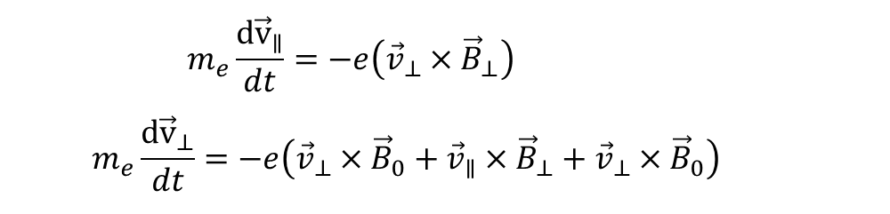
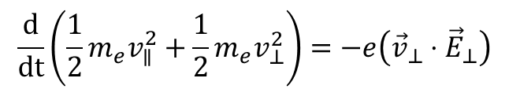
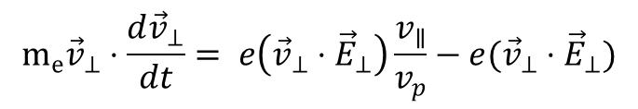
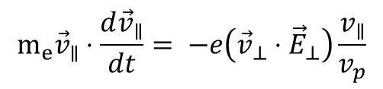
Appendix:
Classical analysis of Anomalous Doppler Resonant without consider static electric field
$$\begin{aligned}m_{e}\frac{{d\vec{v}}_{∥}}{dt}=−e\left({\vec{v}}_{⊥}×{\vec{B}}_{⊥}\right) \#\end{aligned}$$
$$\begin{aligned}m_{e}\frac{{d\vec{v}}_{⊥}}{dt}=−e\left({\vec{v}}_{⊥}×{\vec{B}}_{0}+{\vec{v}}_{∥}×{\vec{B}}_{⊥}+{\vec{v}}_{⊥}×{\vec{B}}_{0}\right)\#\end{aligned}$$
${\vec{B}}_{⊥}=\frac{{\vec{e}}_{k}×{\vec{E}}_{⊥}}{v_{p}}$
$$m_{e}{\vec{v}}_{∥}⋅\frac{d{\vec{v}}_{∥}}{dt}= −e\left({\vec{v}}_{⊥}⋅{\vec{E}}_{⊥}\right)\frac{v_{∥}}{v_{p}}$$
$$m_{e}{\vec{v}}_{⊥}⋅\frac{d{\vec{v}}_{⊥}}{dt}= e\left({\vec{v}}_{⊥}⋅{\vec{E}}_{⊥}\right)\frac{v_{∥}}{v_{p}}−e({\vec{v}}_{⊥}⋅{\vec{E}}_{⊥})$$
$$\frac{d}{dt}\left(\frac{1}{2}m_{e}v_{∥}^{2}+\frac{1}{2}m_{e}v_{⊥}^{2}\right)=−e\left({\vec{v}}_{⊥}⋅{\vec{E}}_{⊥}\right)$$
总能量变化：

Slide 4
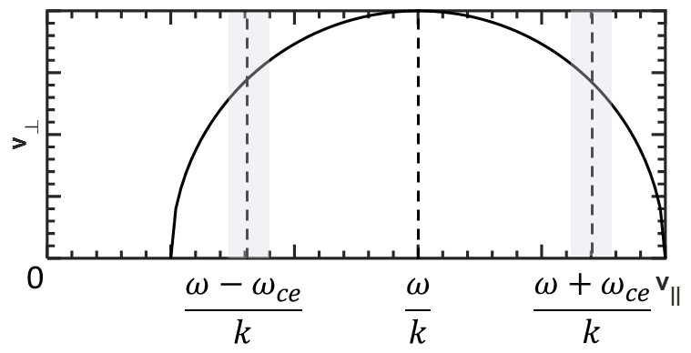
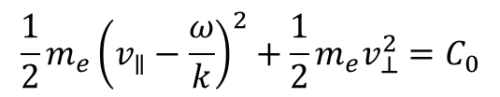
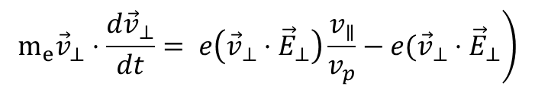
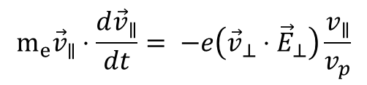
速度依赖关系：
$$m_{e}{\vec{v}}_{∥}⋅\frac{d{\vec{v}}_{∥}}{dt}= −e\left({\vec{v}}_{⊥}⋅{\vec{E}}_{⊥}\right)\frac{v_{∥}}{v_{p}}$$
$$\frac{1}{2}m_{e}{\left(v_{∥}−\frac{ω}{k}\right)}^{2}+\frac{1}{2}m_{e}v_{⊥}^{2}=C_{0}$$
$$\left.m_{e}{\vec{v}}_{⊥}⋅\frac{d{\vec{v}}_{⊥}}{dt}= e\left({\vec{v}}_{⊥}⋅{\vec{E}}_{⊥}\right)\frac{v_{∥}}{v_{p}}−e({\vec{v}}_{⊥}⋅{\vec{E}}_{⊥}\right)$$

Slide 5
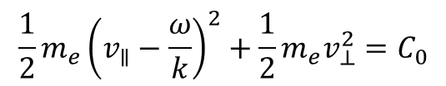
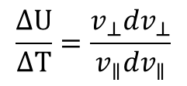
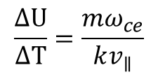

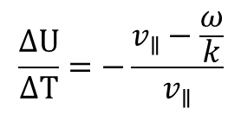
能量转化关系：
$$\frac{1}{2}m_{e}{\left(v_{∥}−\frac{ω}{k}\right)}^{2}+\frac{1}{2}m_{e}v_{⊥}^{2}=C_{0}$$
$$\frac{ΔU}{ΔT}=\frac{v_{⊥}dv_{⊥}}{v_{∥}dv_{∥}}$$
$$\frac{ΔU}{ΔT}=−\frac{v_{∥}−\frac{ω}{k}}{v_{∥}}$$
$$ω=kv_{∥}+mω_{ce}$$
$$\frac{ΔU}{ΔT}=\frac{mω_{ce}}{kv_{∥}}$$

